Slide 1

A Controls Engineer’s perspective on ICS/OT cybersecurity impact

Slide 2
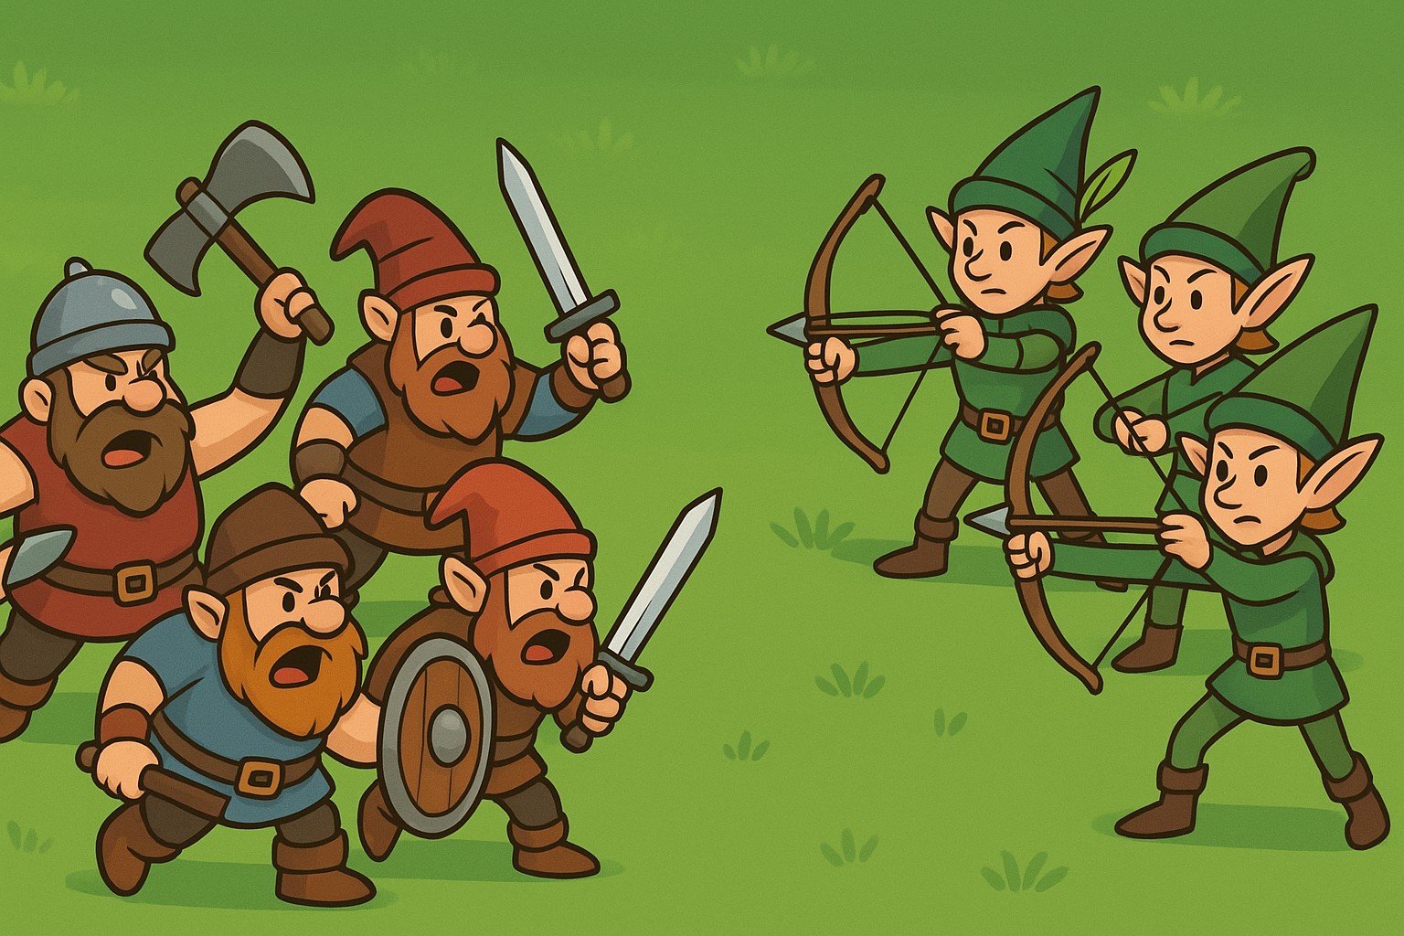

background
ICS/OT Cybersecurity is necessary!
If it is necessary, where are the impactful events?!?

Slide 3
A controls engineer has more
Potential to impact a system than a threat actor
And that is a good thing!!!
Notes:
WHY?
Controls engineer has context.
The place that a TA has us beat is in complete operational disruption.

Slide 4
Neil Brandon
Who am i?
GICSP, GRID, GCIP, Sec+
Principal Engineer @ Faith technologies
  Data center team
20+ years industrial automation
  Machine vision
  Robotics
  Industrial machine learning

Slide 5

We need to define impact!
Primary categories of concern for ICS/OT
production
Safety

Slide 6
Agenda
Can Impact Happen?
What would cause impact?
What prevents impact from occurring?
What areas should we concentrate on to minimize exposure?
Notes:
Challenge our assumptions

Slide 7
Why haven’t we seen impact?
Can impact happen?
The fundamental question

Slide 8
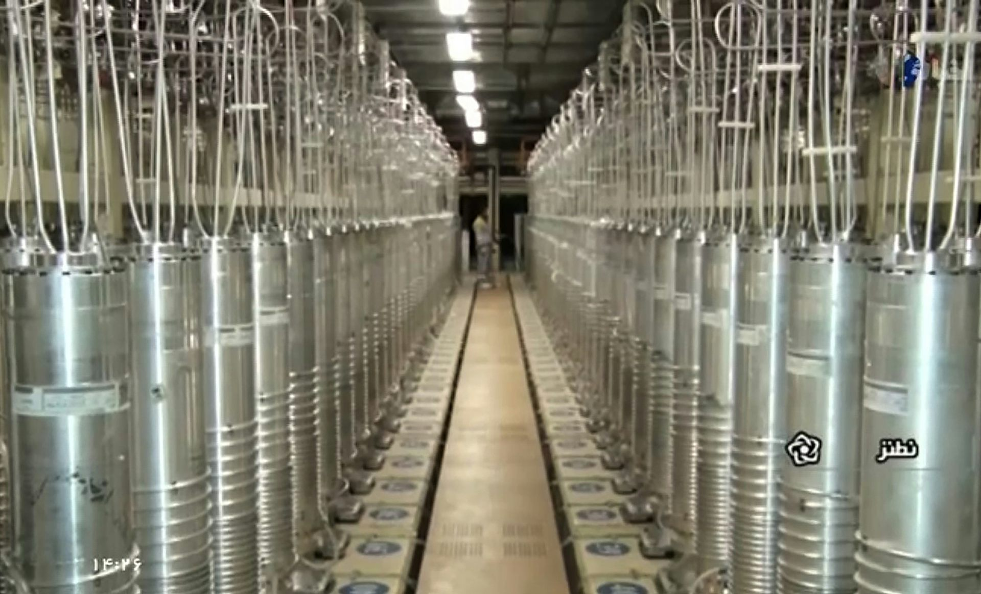
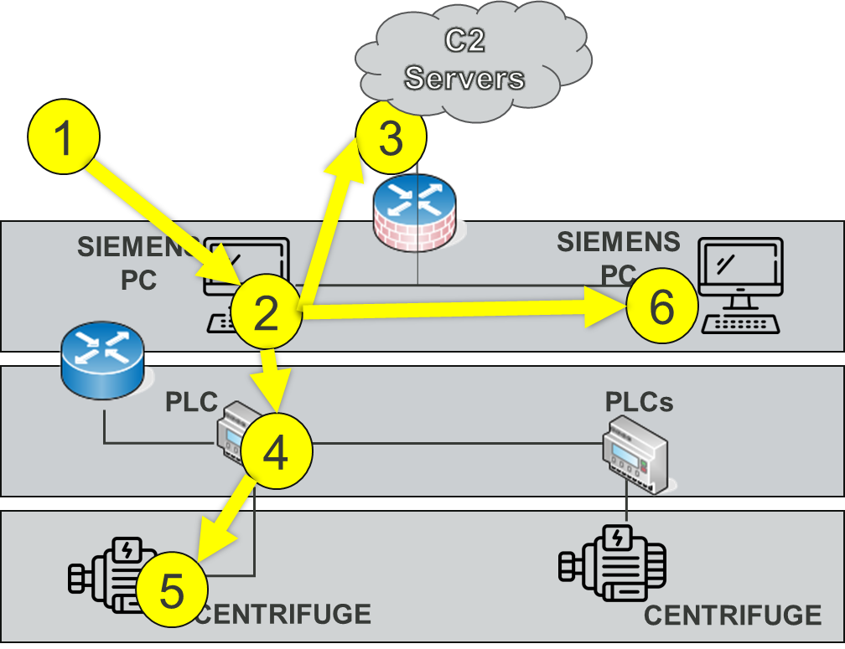
Natanz, iran - stuxnet
Notes:
Sophisticated Malware

Slide 9
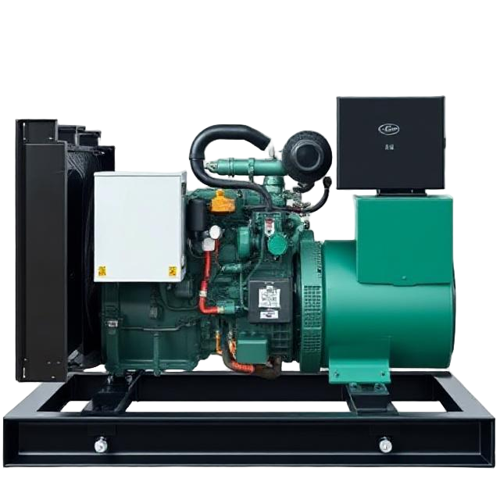
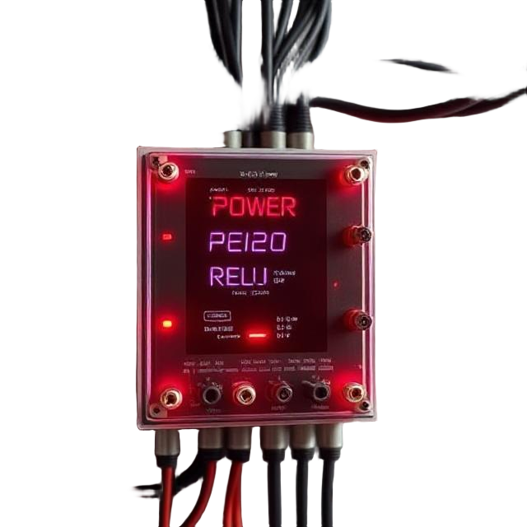
Idaho national labs - aurora test
Notes:
27 ton diesel generator
Protective breaker open and close rapidly
Similar to shifting into 1st gear on the highway

Slide 10
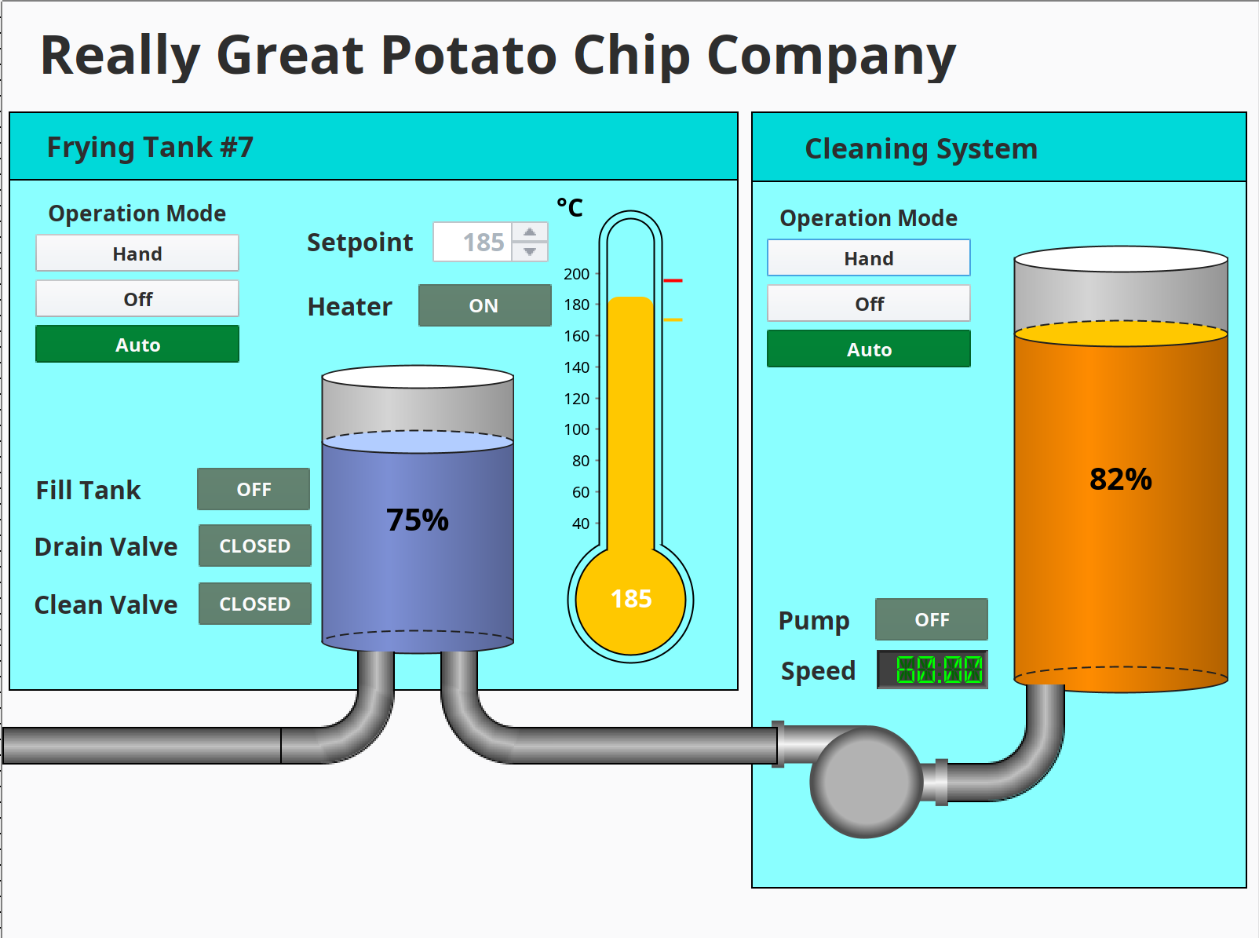
Potato
Chip
Factory wisconsin

Slide 11
Are there threat actors attempting to cause impact?

Slide 12
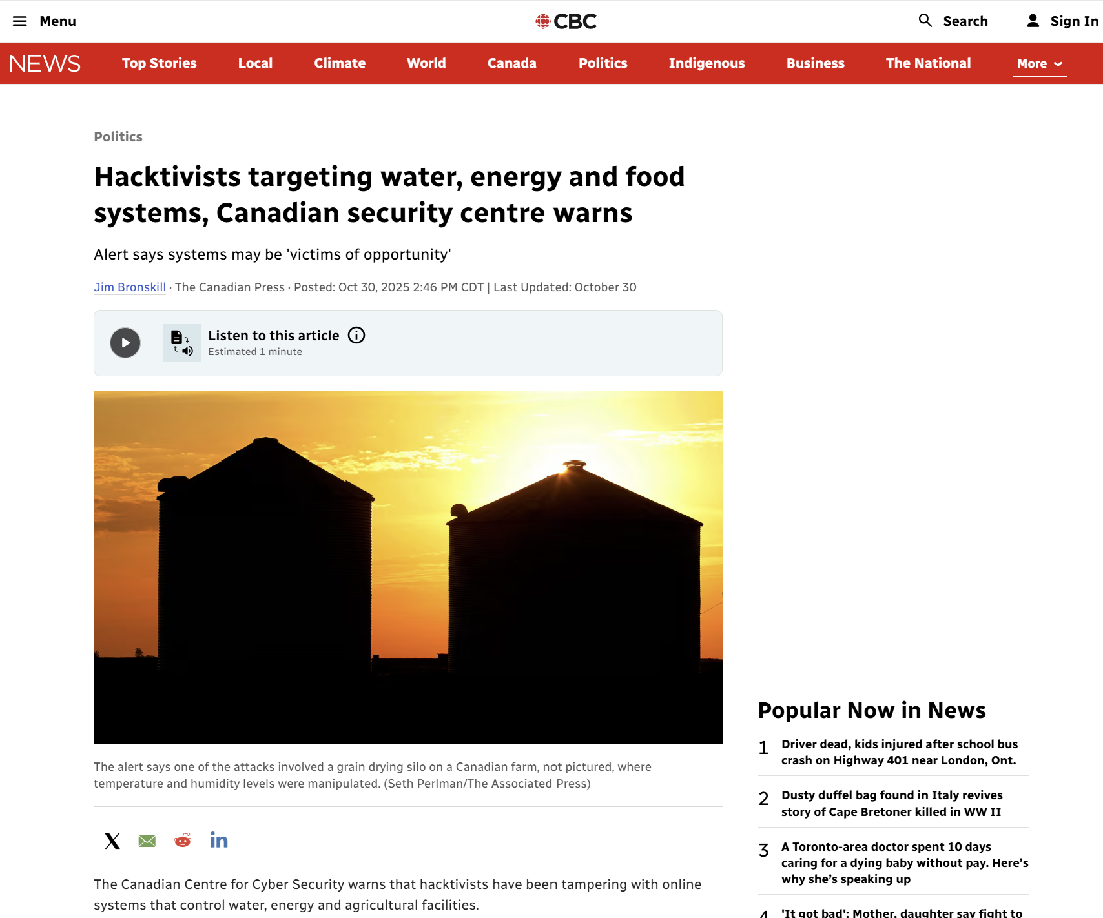
Recent Canadian example
October 30, 2025
Adjusted water pressure at a facility that serviced a community.
Triggered a false alarm at an oil & gas facility
Adjusted temperature and humidity of a grain silo

Slide 13
What prevents impact from occurring?

Slide 14
Lack of context
(don’t know where the problems are)

Slide 15
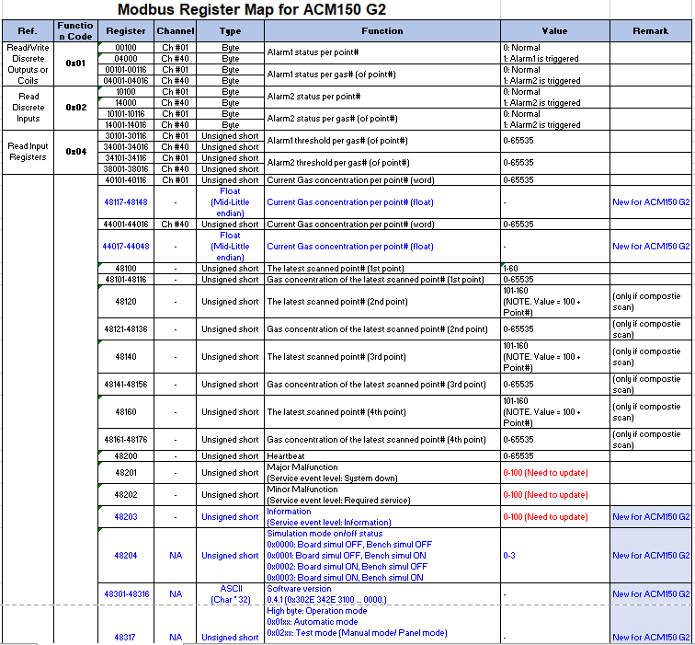
1
Determine what’s talking
2
What type of device is it?
3
Is it talking to something else?
4
ARe there other points?
5
Are they rw / ro?
6
Move ns / ew

Slide 16
without context it’s
not easy to determine impact

Slide 17
Potato
Chip
Factory
Context
Is key!

Slide 18
Failsafes
(physical controls)
(Engineeringing controls)
Notes:
To fail safety

Slide 19
The Best Failsafe
is one that cannot be controlled
Notes:
To fail safety

Slide 20
second Best option
control at the lowest level possible
Notes:
To fail safety

Slide 21
control to the level appropriate to the risk
Notes:
To fail safety

Slide 22
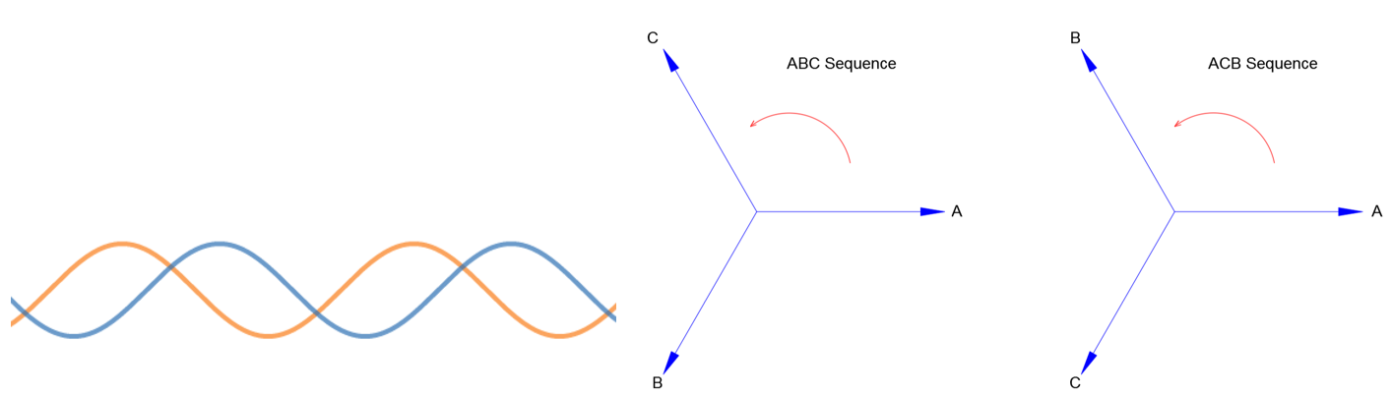
Idaho national labs - aurora test
Protection relays now implement
ANSI 25 Function (Synchrocheck)
Notes:
27 ton diesel generator
Protective breaker open and close rapidly
Similar to shifting into 1st gear on the highway

Slide 23
Potato
Chip
Factory wisconsin

Slide 24
stuxnet failsafe?
Notes:
To fail safety

Slide 25
control to the level appropriate to the risk
Notes:
To fail safety

Slide 26
What areas should we concentrate on to minimize exposure?

Slide 27

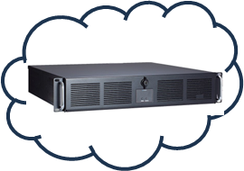




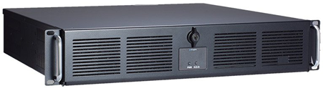
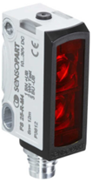
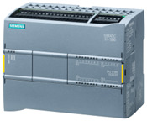

Enterprise cloud
Controls
engineer
process
engineer
erp
operations
Site scada
historian
mes
Line scada
Machine 2
Machine 1

Slide 28
Interactions between enterprise it and ot services

Slide 29
Enterprise cloud
Controls
engineer
process
engineer
erp
operations
Site scada
historian
mes
Line scada
Machine 2
Machine 1

Slide 30
Scada systems /
The integration between production machines
Especially web-based!
Notes:
My opinion - This is the most critical piece of the puzzle
Crown jewel? Maybe, maybe not. Is dependant on situation.

Slide 31
Enterprise cloud
Controls
engineer
process
engineer
erp
operations
Site scada
historian
mes
Line scada
Machine 2
Machine 1

Slide 32
Notes:
SCADA systems provide context
What does this system do?
Where are the painpoints?

Slide 33
prioritize Systems with higher risk
Notes:
My opinion - This is the most critical piece of the puzzle
Crown jewel? Maybe, maybe not. Is dependant on situation.

Slide 34
Enterprise cloud
Controls
engineer
process
engineer
erp
operations
Site scada
historian
mes
Line scada
Machine 2
Machine 1
Notes:
In addition to CJA, consider kinetic or safety systems

Slide 35
guard your scada!
Know your risk!
minimize your impact!
Notes:
To fail safety

Slide 36
Thank you!
Notes:
To fail safety

Slide 37
Questions?
Notes:
To fail safety

